Slide 1
A Neural Probabilistic Language Model
Yoshua Bengio, Réjean Ducharme, Pascal Vincent, Christian Jauvin

Slide 2
Introduction to the problem
Curse of Dimensionality in language modelling
Estimating probabilities for word sequence is difficult
Large vocabulary >>> huge number of potential word combinations
Need for efficient generalization to unseen word sequences

Slide 3
Previous Approach: N-Gram Model
N-gram models(e.g. trigrams, bigrams, etc)
Predict next word based on preceding words
P(wt​∣wt−1​,wt−2​,…,wt−n+1​)
P(wt​∣wt−1​,wt−2​,…,wt−n+1​) ≈ Count(wt−n+1​,…,wt−1​) / Count(wt−n+1​,…,wt​)​
P(running∣the dog is )=Count("the dog is running") / Count("running")​
Build conditional probabilities for short word contexts
Techniques to handle unseen word sequences
Backoff: If a trigram is unseen, we back off to the bigram: P(wt​∣wt−1​,wt−2​)≈>P(wt​∣wt−1​)
Smoothing: helps prevent zero probabilities for unseen word combinations
Katz Back-off Smoothing
Kneser-Ney Smoothing

Slide 4
Limitations of N-Gram Models
Short context windows (only 2-3 words considered)
No semantic similarity between words (e.g., "dog" vs. "cat")
Curse of dimensionality: exponential growth in the number of word
Poor generalization to new word combinations

Slide 5
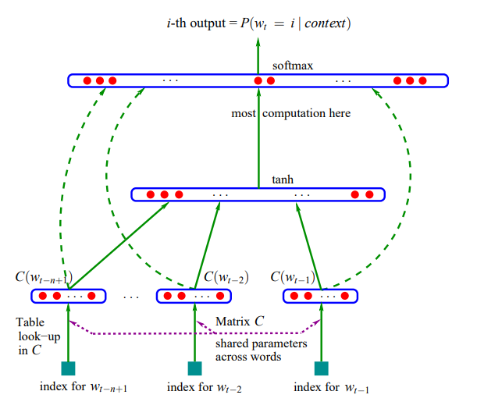
Neural Probabilistic Language Model(NPLM)
Idea: Use distributed word representations (word embeddings)
Word embeddings: each word mapped to a real-valued vector
Neural Network Architecture
The embedding layer that converts words into vector representations.
The feed-forward neural network that learns to predict the next word.
Notes:
to address the curse of dimensionality using a neural network-based probabilistic language model that learns distributed representations for words.
Each element in the output vector, P(wt=i∣context)P(w_t = i | \text{context})P(wt​=i∣context), represents the probability of the next word wtw_twt​ being the iii-th word in the vocabulary, given the context of the previous words.

Slide 6
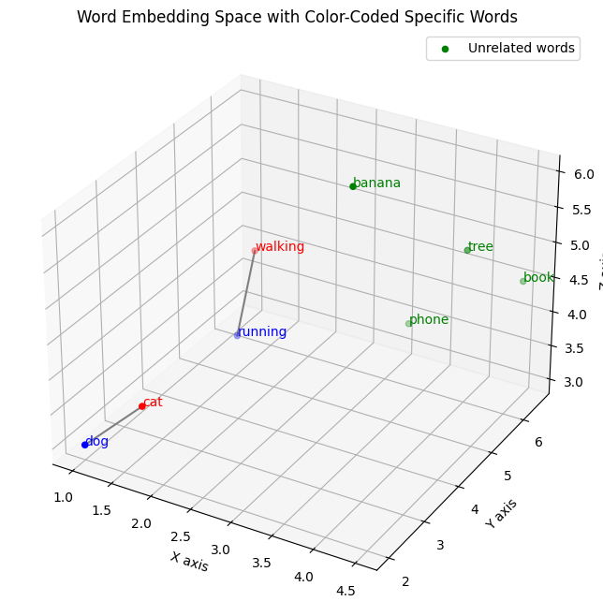
Word Embeddings
Ensuring that semantically similar are close to each other in the vector space.
Example:
“The dog was running in a room”
“The cat is walking in the room”
Notes:
imagine the sentence “The dog was running in a room” is in the training corpus, but “The cat is walking in the room” is not.
if the word embeddings of “dog” and “cat” are similar, the model will generalize to the case of “cat”.
the neural network could predict similar sentences based on the representation of those words: “The cat was sleeping in the room” “The dog was sleeping in the room”

Slide 7
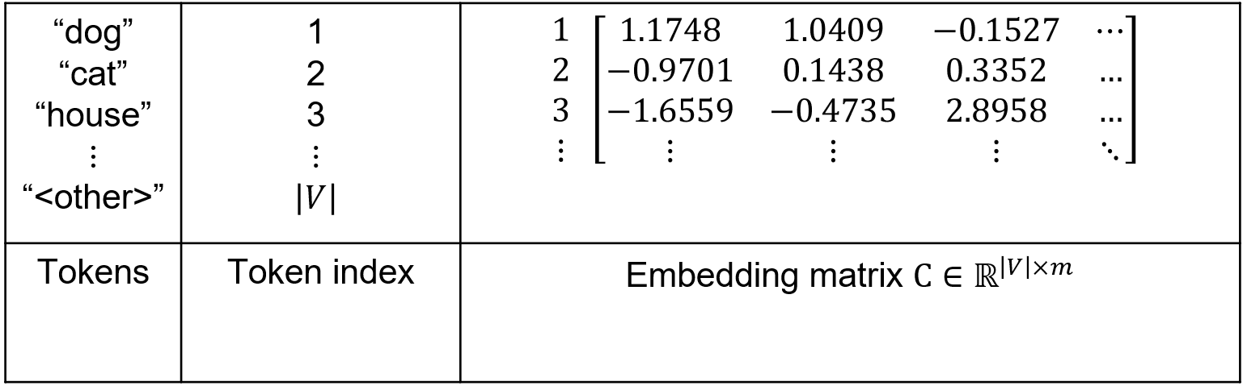
Embedding is just using a lookup table

Slide 8
How are these embeddings learned?
Just like any other parameter:
Initialized randomly
Updated through gradient descent & backpropagation
Why do similar tokens have similar embeddings?
Because that minimizes loss.
If two tokens, like "dog" and "puppy" are both used in similar sentences, then it helps the model make better predictions for them to have close vector representations.
The embeddings end up having semantic meaning.
Notes:
Why do similar tokens have similar embeddings?
Because that minimizes loss.
If two tokens like "dog" and "puppy" are both used in similar sentences in the training corpus, then it helps the model for them to have close vector representations. That helps in making better predictions. For example predicting that “barks” comes after both

Slide 9
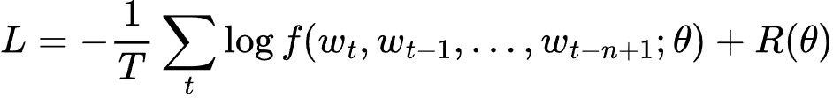
Loss function
Negative log-likelihood
Maximizes the ML estimate of observing the the training corpus
Regularized by weight decay

Slide 10
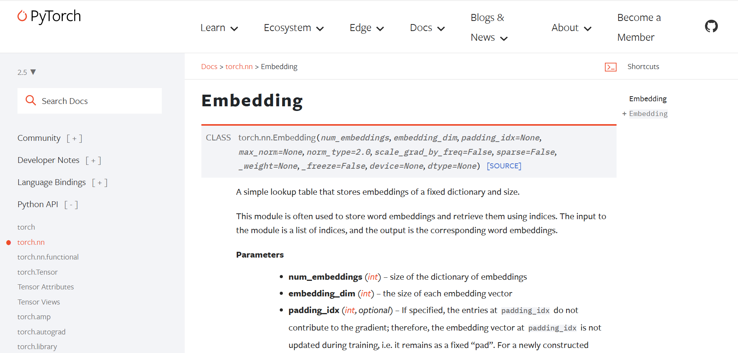
In practice today

Slide 11
Results
Better perplexity than previously best n-gram models
Neural network was able to take advantage of more context (on Brown corpus, going from 2 words of context to 4 words brought improvements to the neural network, not to the n-grams)
Model | Perplexity on test data
Embedding-based MLP | 252
class-based back-off n-gram model | 312

Slide 12
Thank you

